Slide 1
5 voices, 10 stories:
Groningen Harmonization Exercise
IALSA
Andrey Koval
2016-04-21
Groningen, NL

Slide 2
describe|
|harmonize
smoking
D
H
ALSA
dto
age
dto
D
H
LBLS
sex
D
H
Ellis
Island
education
SATSA
harmony
dto
D
H
marital
SHARE
D
H
…
TILDA
construct
D
H

Slide 3
dto
graph
smoke_now
harmony
dto
model

Slide 4
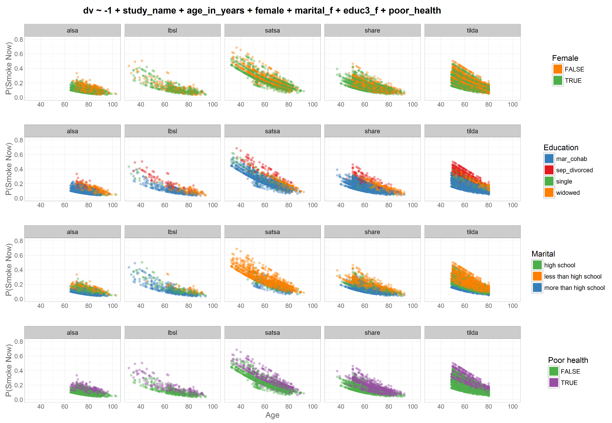
Odds|
|Prob
Study =
factor
dto
harmony
dto

Slide 5
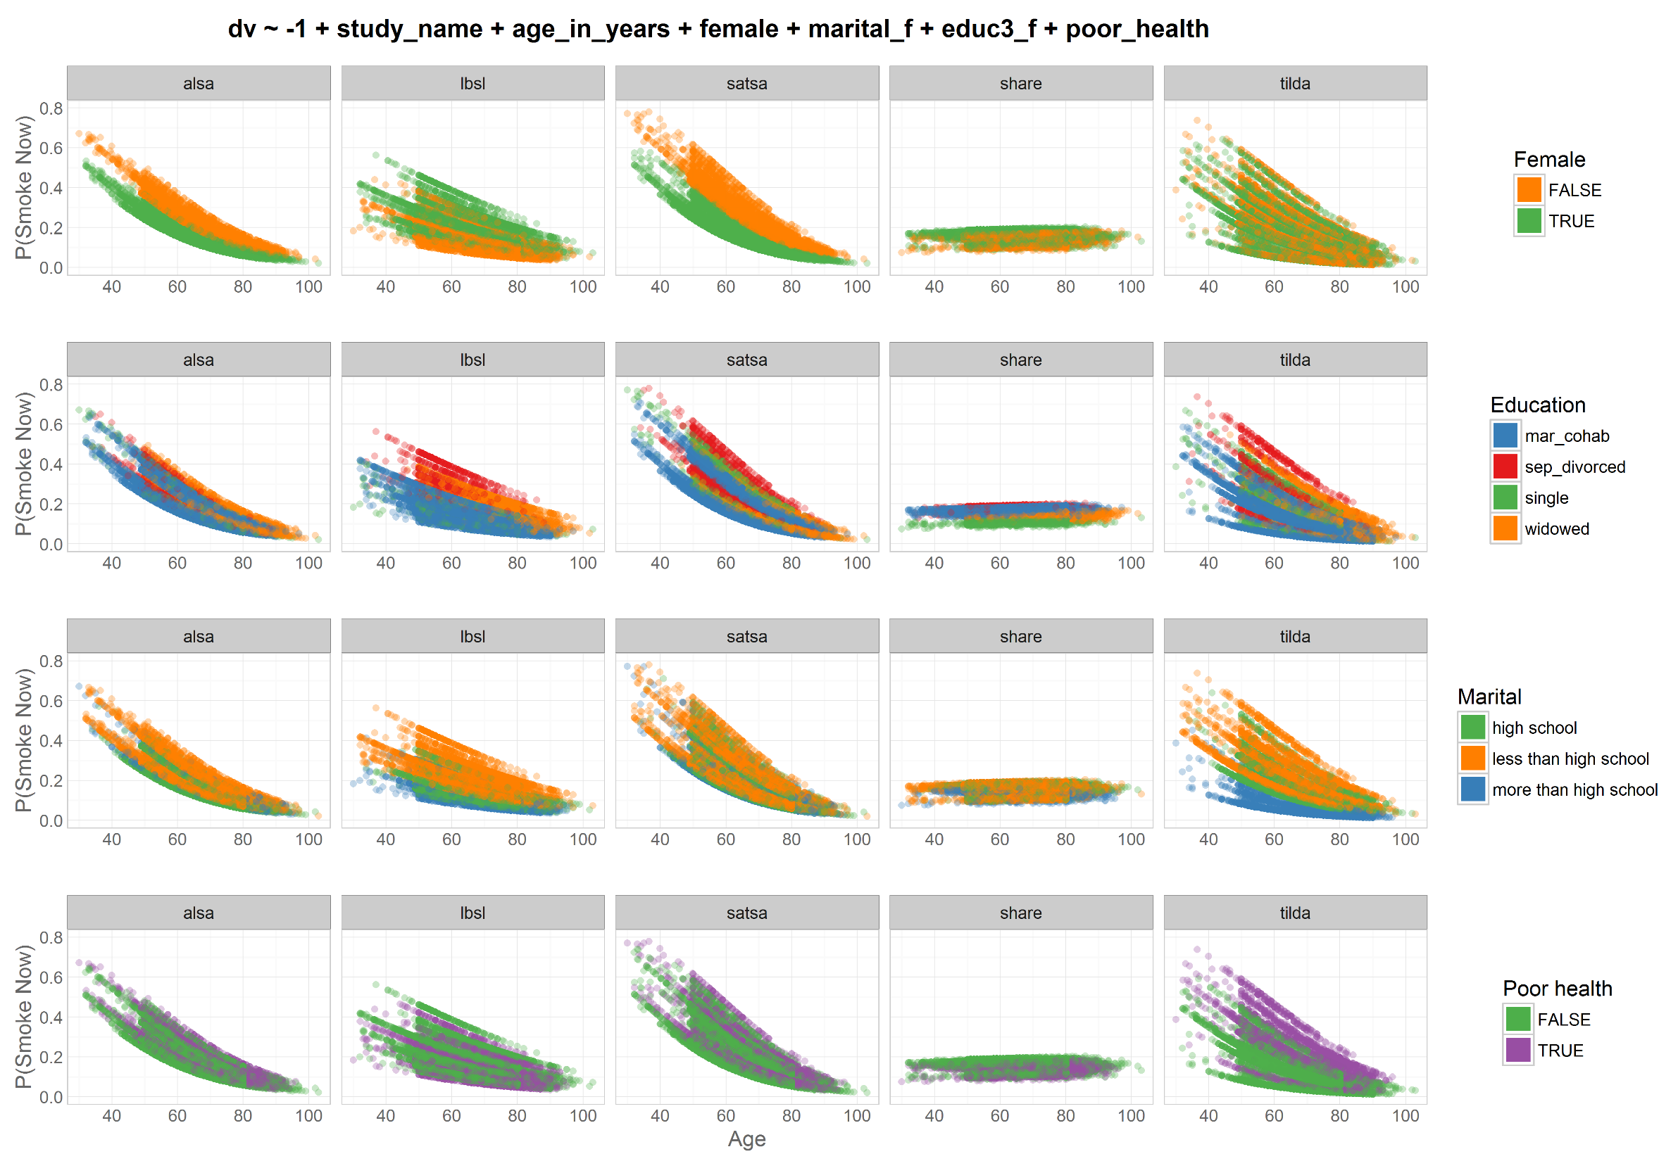
Odds|
|Prob
Study =
cluster
dto
harmony
dto

Slide 6
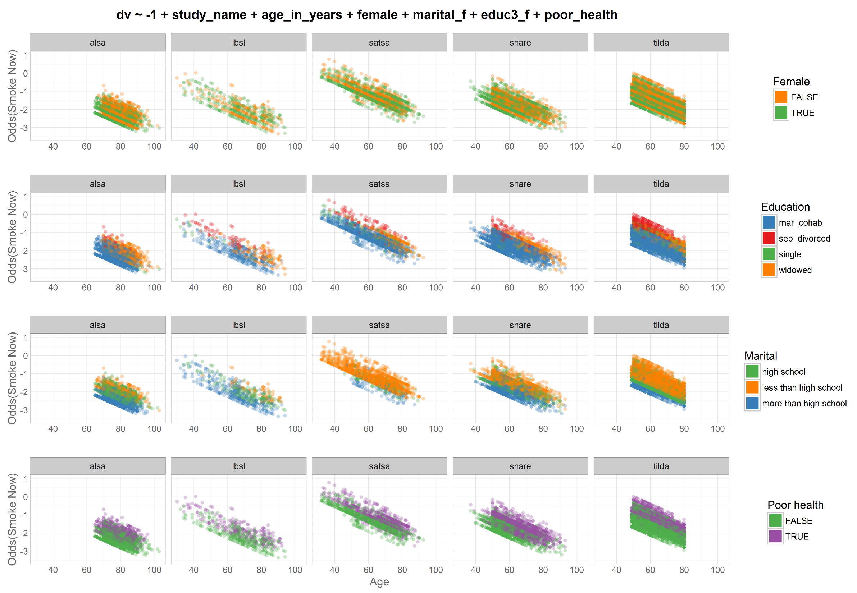
Odds|
|Prob
Study =
factor
dto
harmony
dto

Slide 7
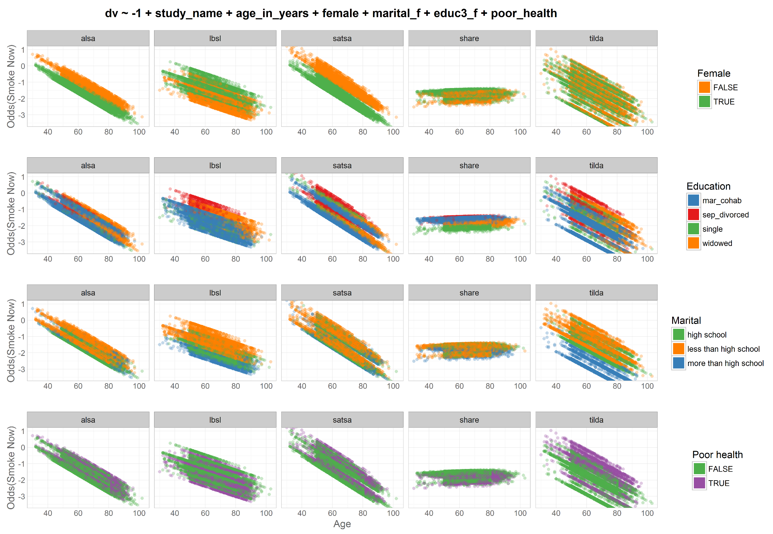
Odds|
|Prob
Study =
cluster
dto
harmony
dto

Slide 8
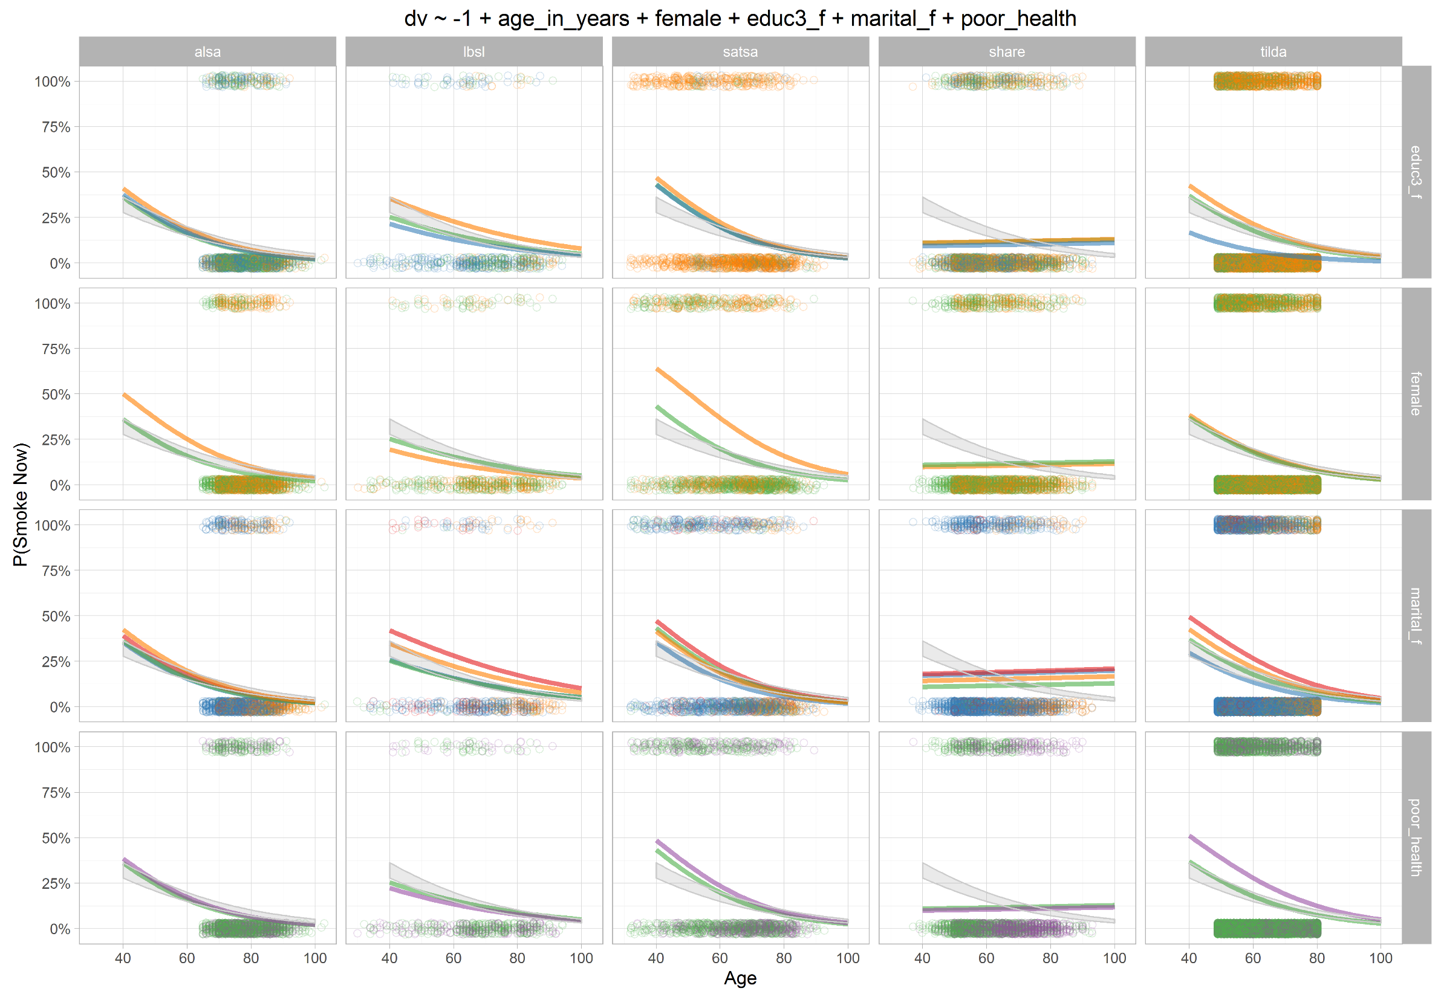
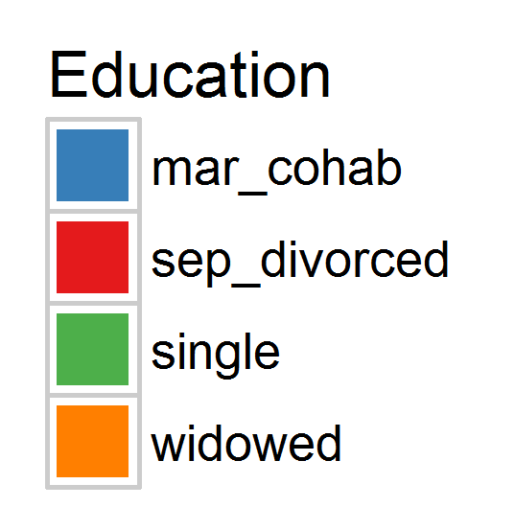
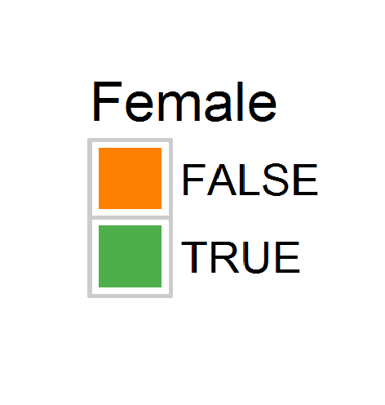
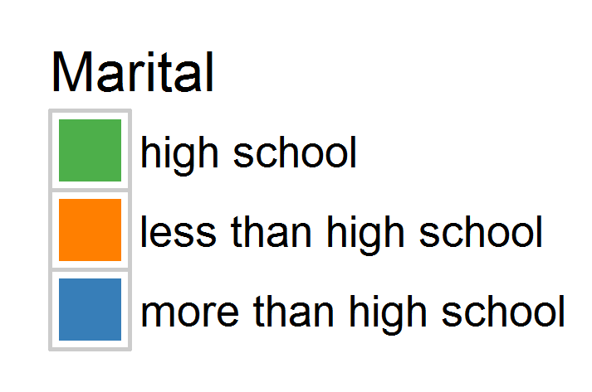
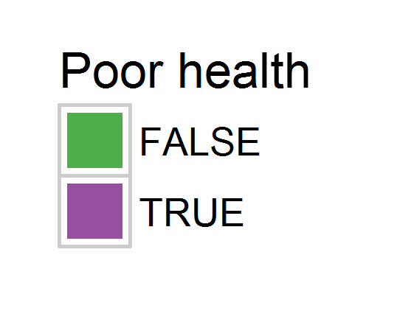
Odds|
|Prob
Study =
cluster

Slide 9
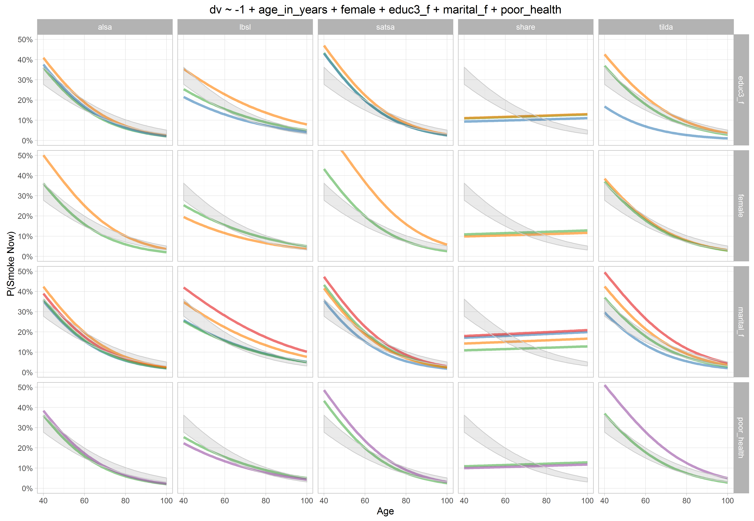
Odds|
|Prob
Study =
cluster

Slide 10
dto
graph
smoked_ever
harmony
dto
model

Slide 11
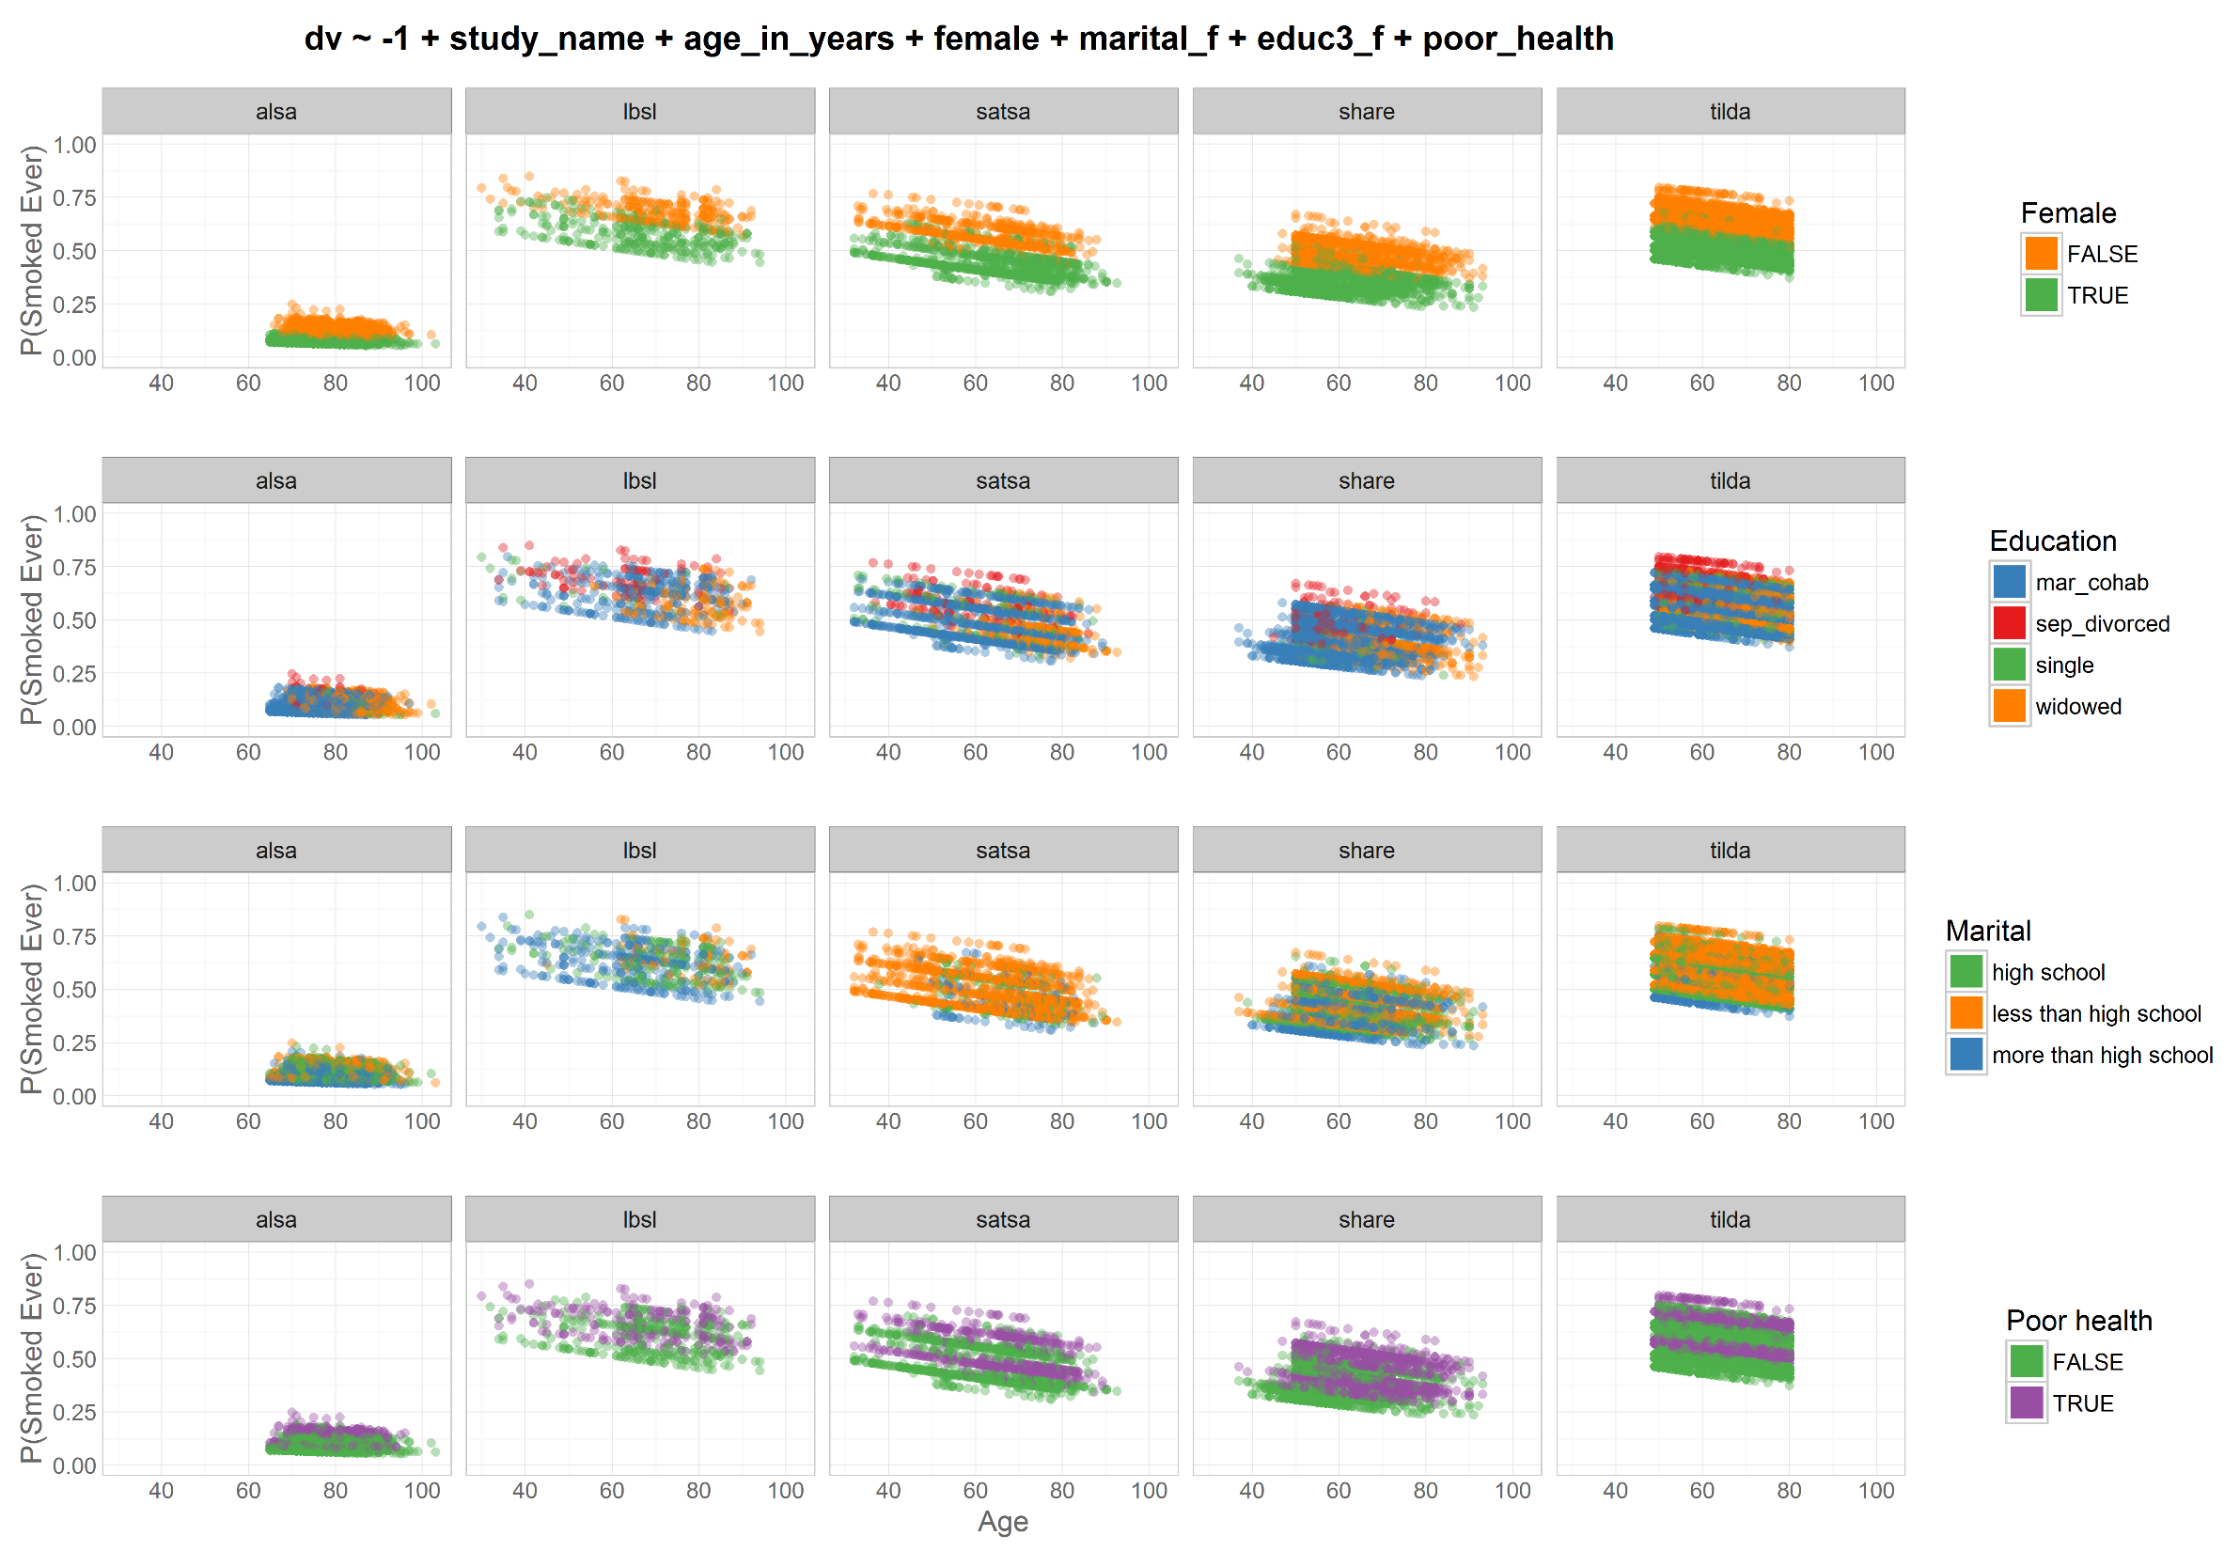
Odds|
|Prob
Study =
factor
dto
harmony
dto

Slide 12
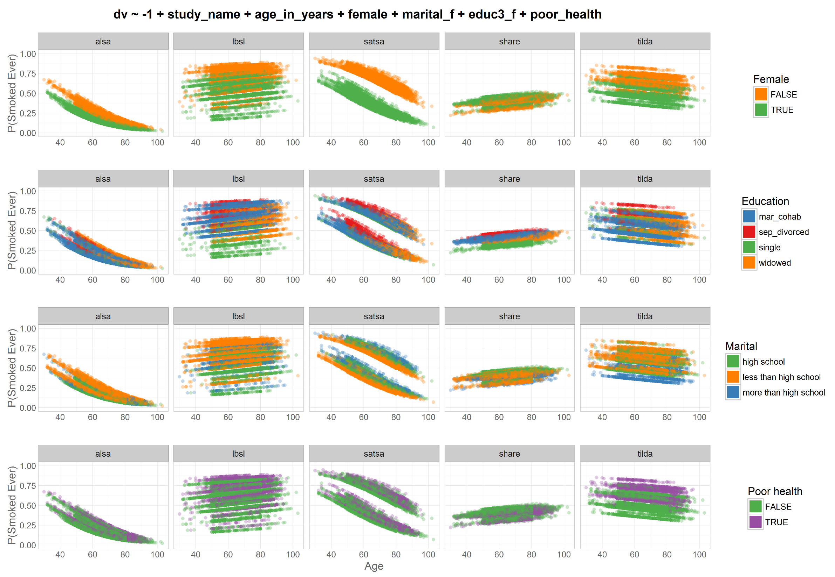
Odds|
|Prob
Study =
cluster
dto
harmony
dto

Slide 13
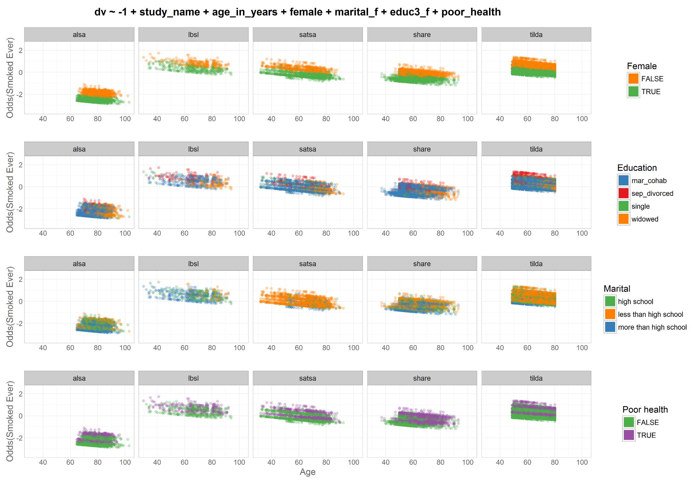
Odds|
|Prob
Study =
factor
dto
harmony
dto

Slide 14
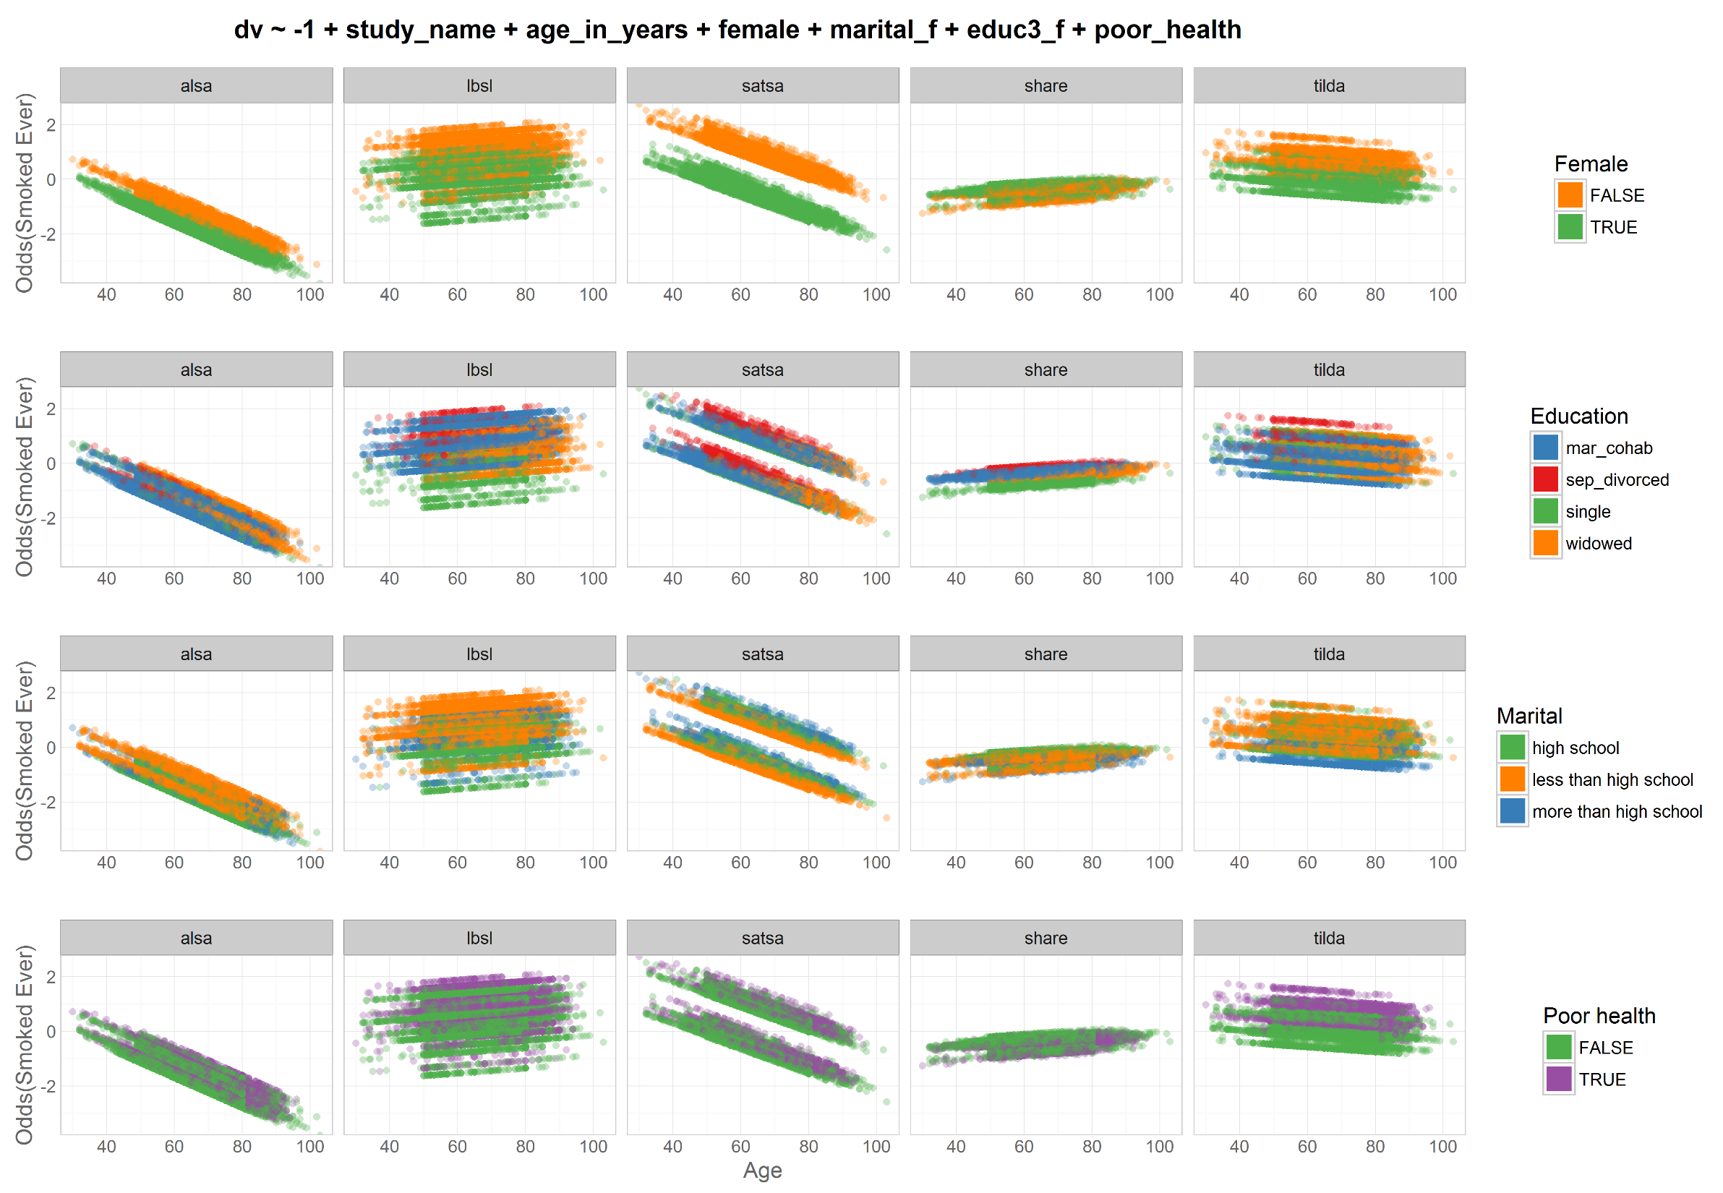
Odds|
|Prob
Study =
cluster
dto
harmony
dto

Slide 15
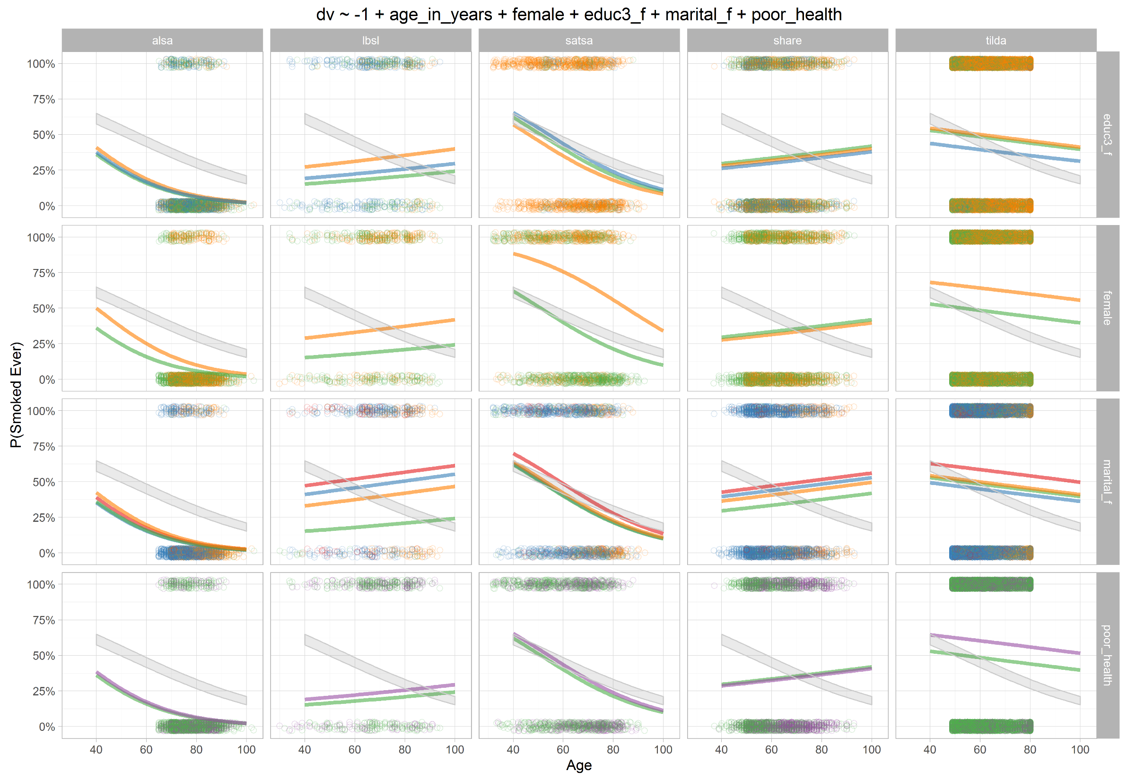
Odds|
|Prob
Study =
cluster

Slide 16
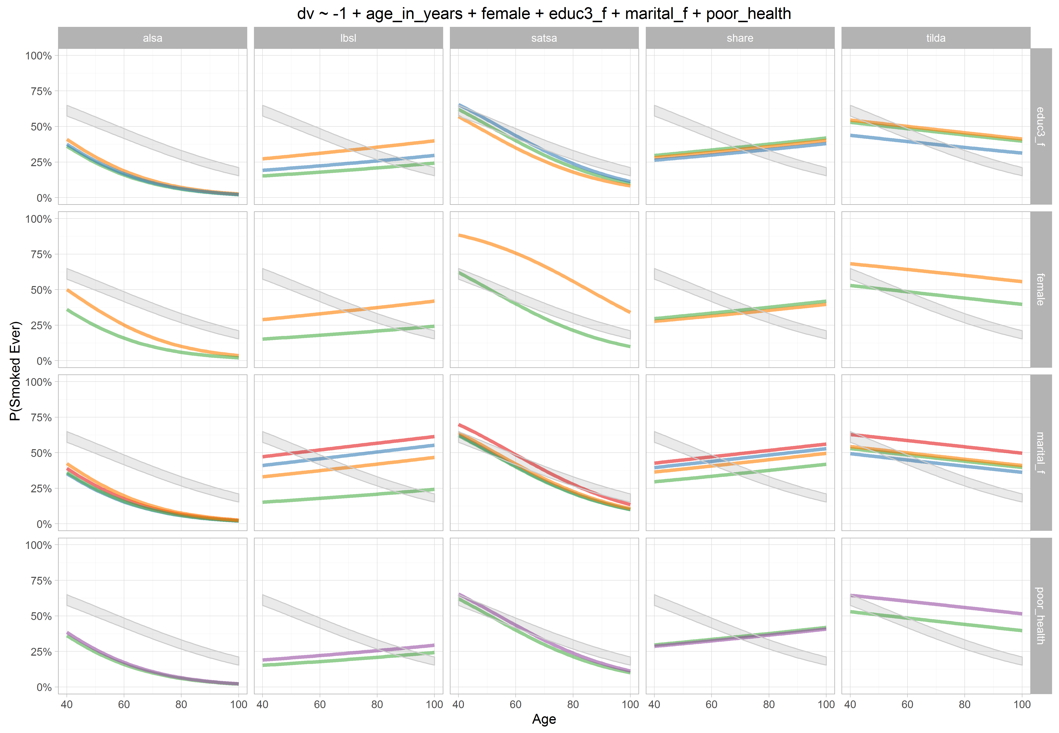
Odds|
|Prob
Study =
cluster

Slide 17
5 voices, 10 stories:
Groningen Harmonization Exercise
IALSA team
Andrey Koval, University of Victoria
Andrea Piccinin, University of Victoria
Scott Hofer, University of Victoria
Graciela Muniz, University College London
Special thanks
William Beasley, University of Oklahoma

